Slide 1
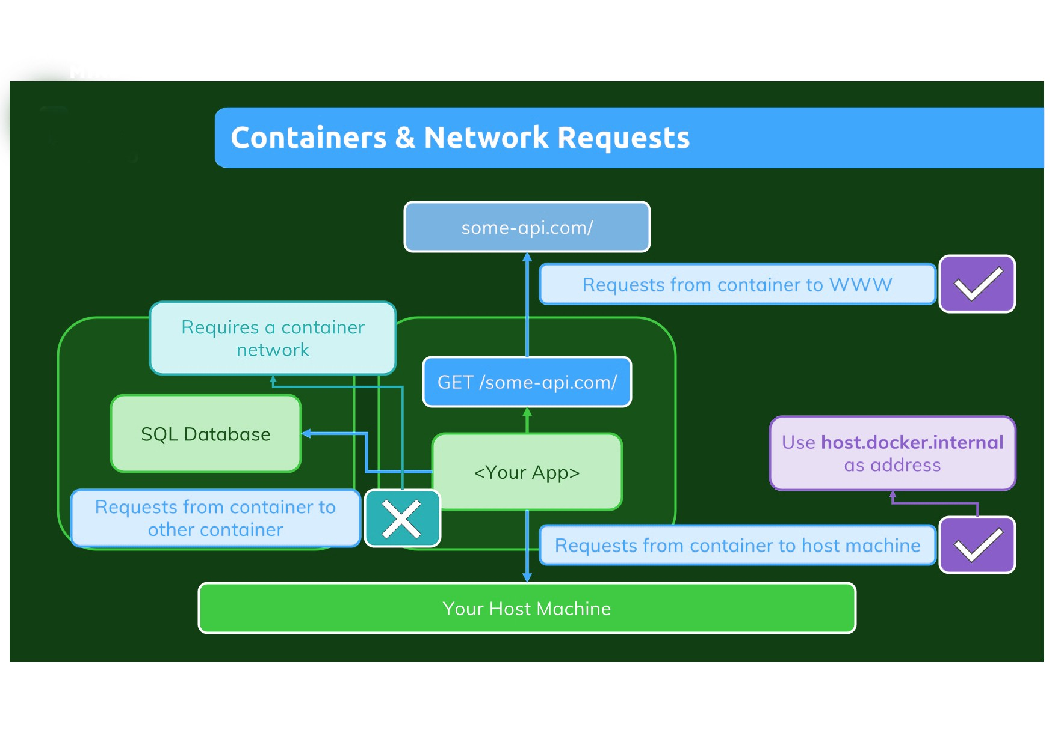

Slide 2
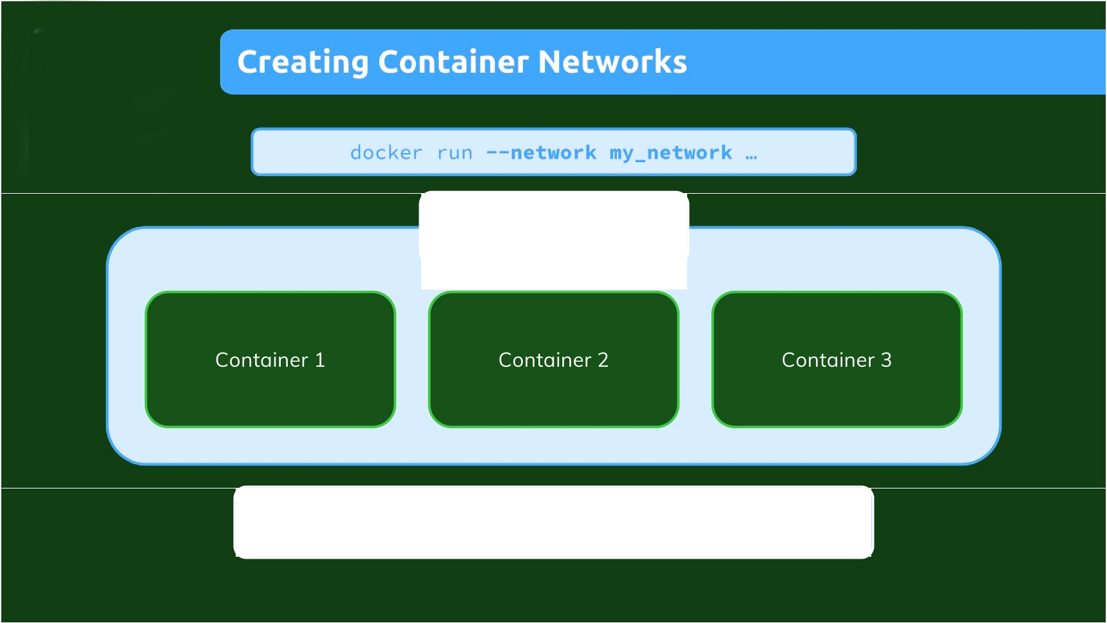
Network
Within a Docker network, all containers can communicate with each other and IPs are automatically resolved

Slide 3

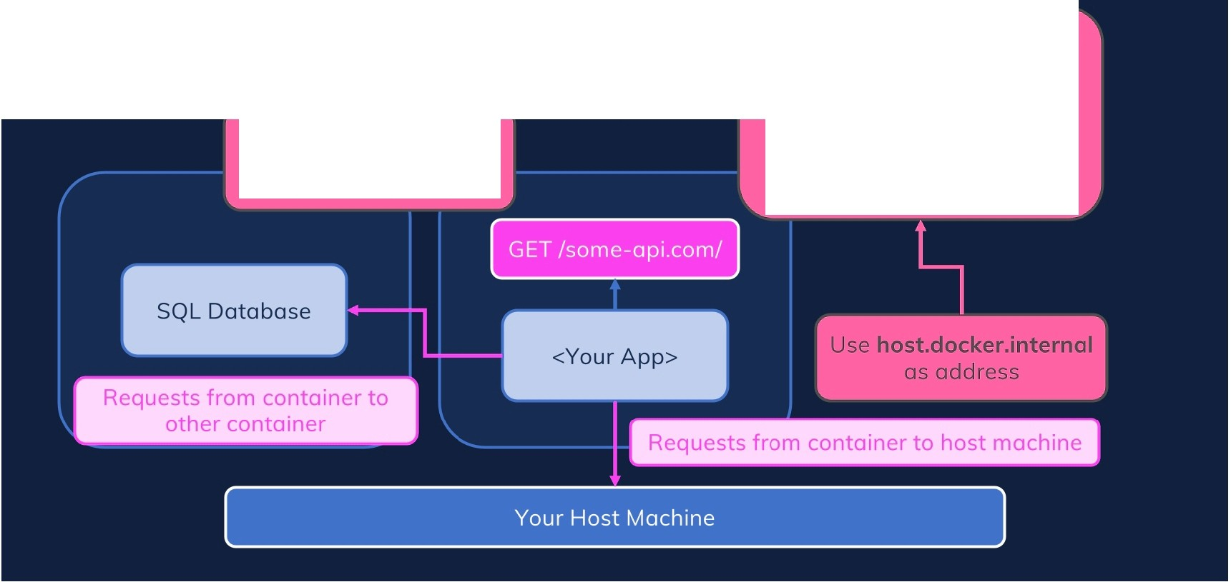
Docker will NOT replace your
source code.
Requires a container network + use container name as address
It simply detects outgoing requests and resolves the IP for such requests

